Slide 1

HDS Tutorial 4 Week 8

Slide 2


Slide 3


Slide 4
HDS Tutorial 4 Week 8

Slide 5




Agenda
Interactive overview of key functions discussed in the course
R Markdown knit to PDF demo
Q&A

Slide 6
Have you managed to successfully knit an R Markdown document to PDF?

Slide 7













Summary of key functions

Slide 8
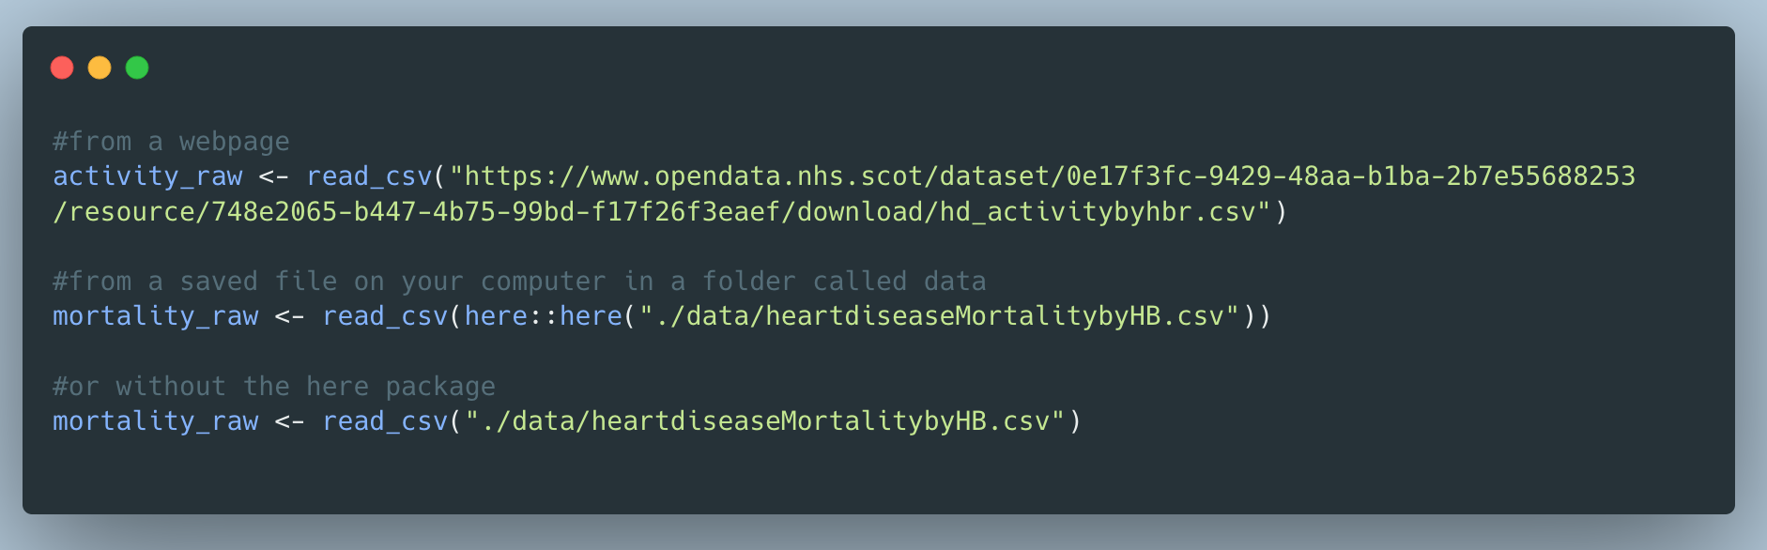
Importing Data
read_csv()

Slide 9
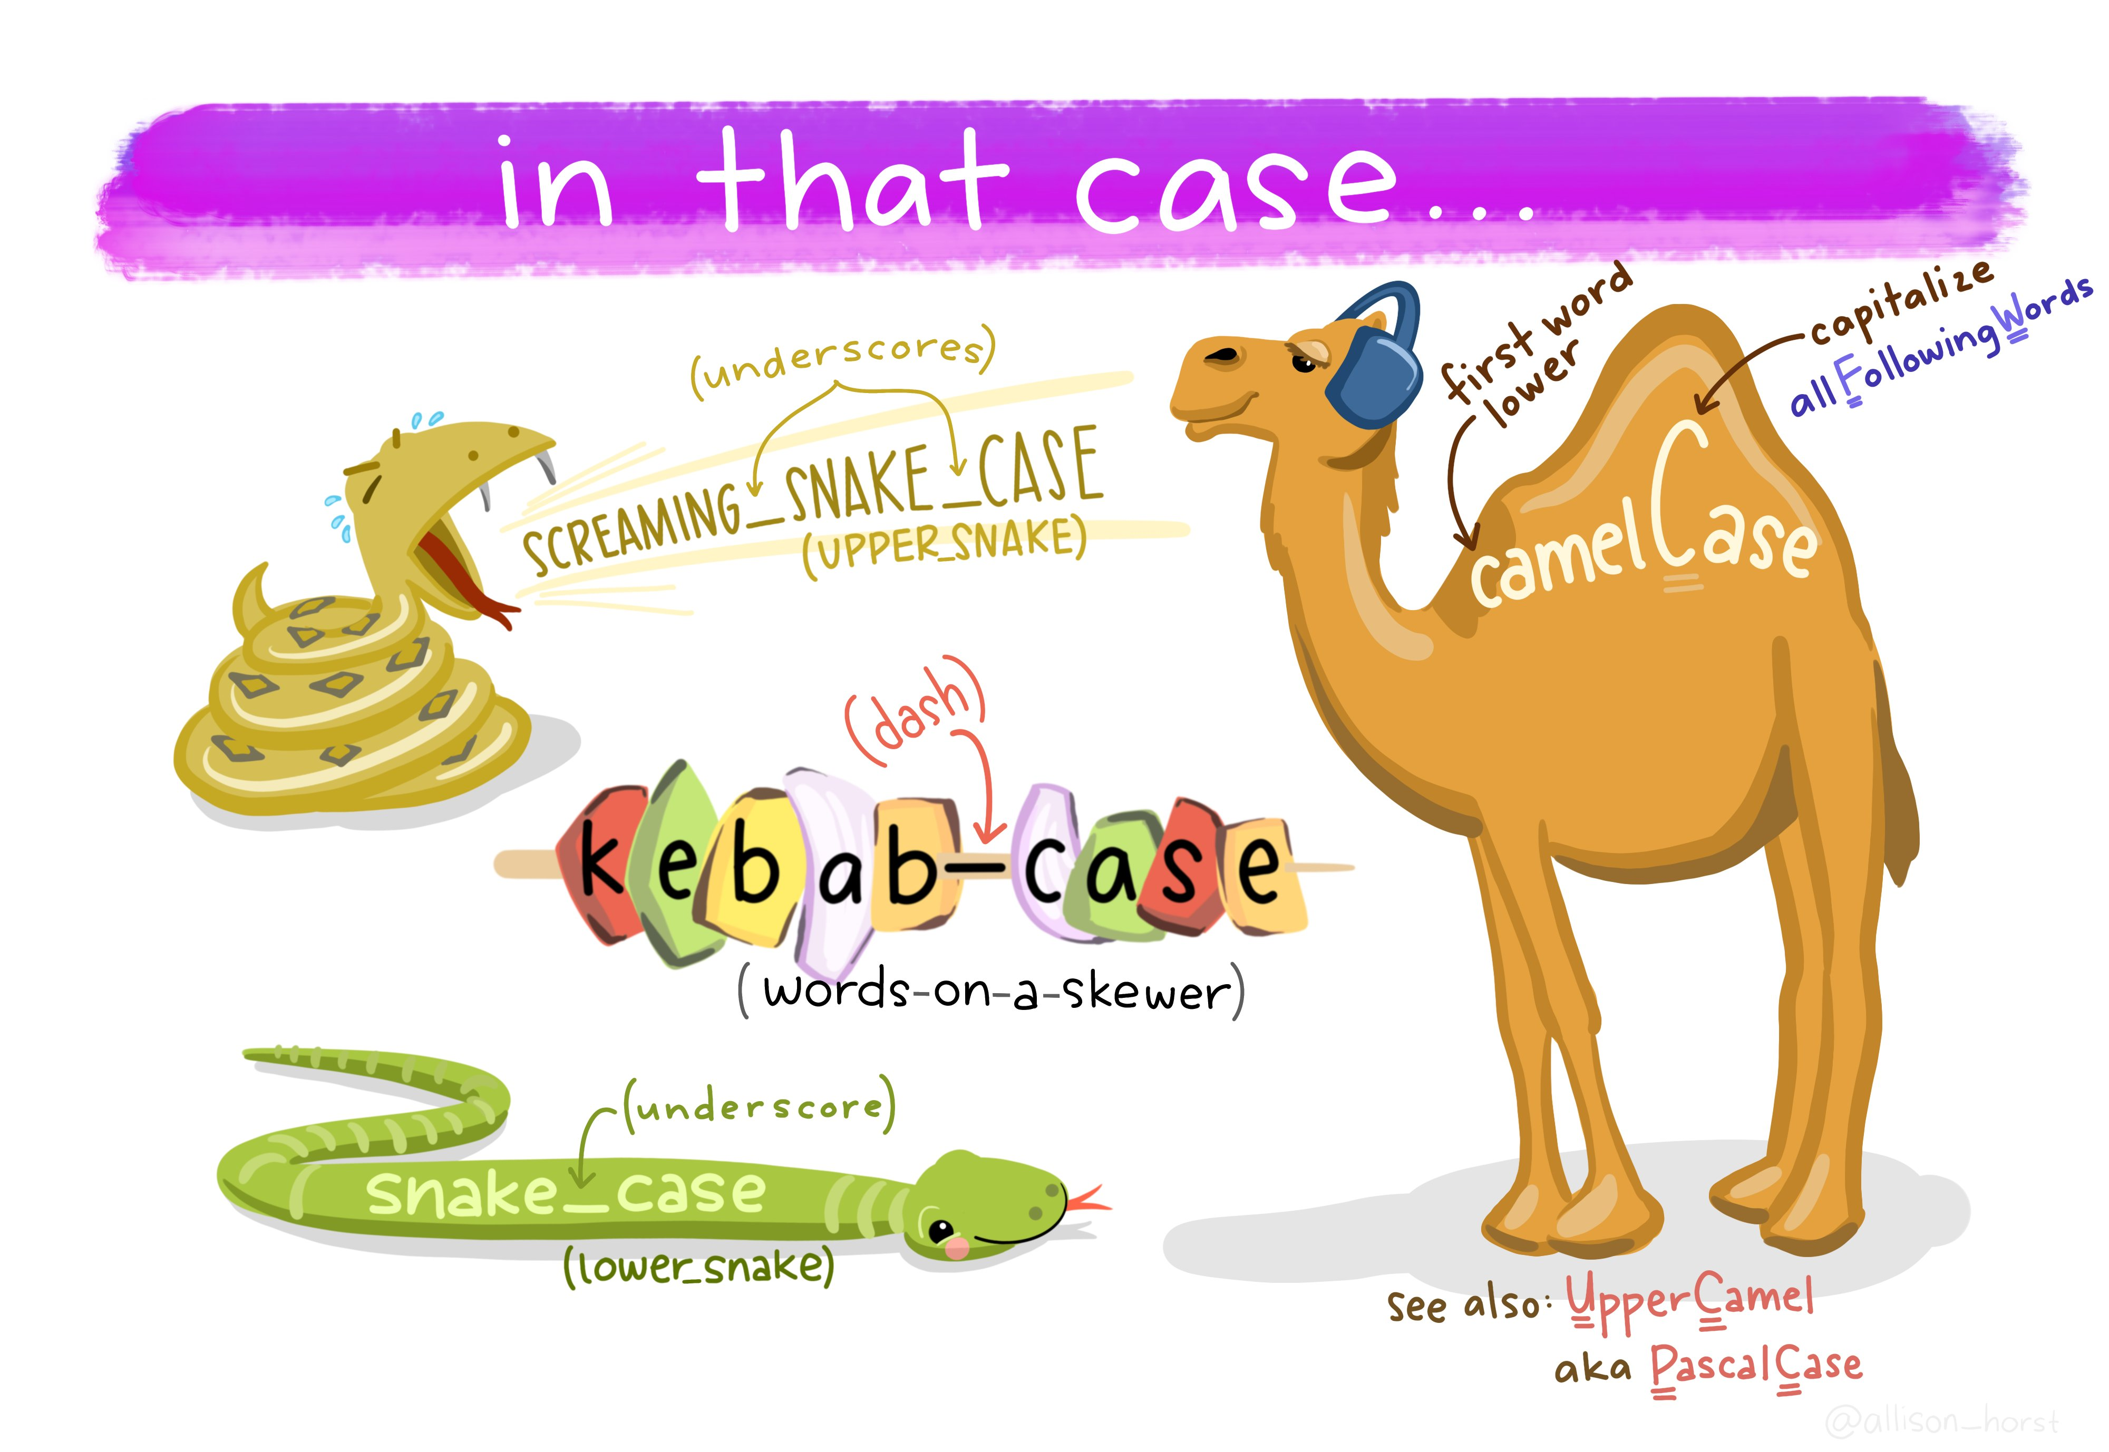
Variable naming conventions
clean_names()
Defaults to snake case, but there are 18 options you can choose from
Artwork by Allison Horst

Slide 10

Wrangling
Artwork by Allison Horst

Slide 11
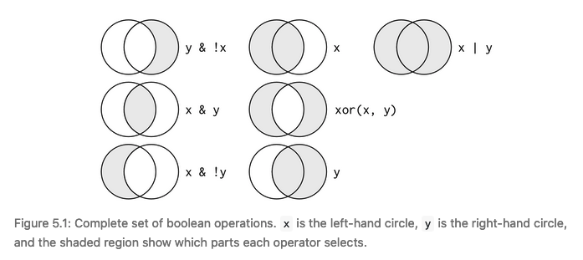
Logical Operators
< | Less than
> | Greater than
== | Equal to
<= | Less than equal to
>= | Greater than equal to
!= | Not equal to
%in% | Group membership
Source: R for Data Science book, Figure 5.1

Slide 12
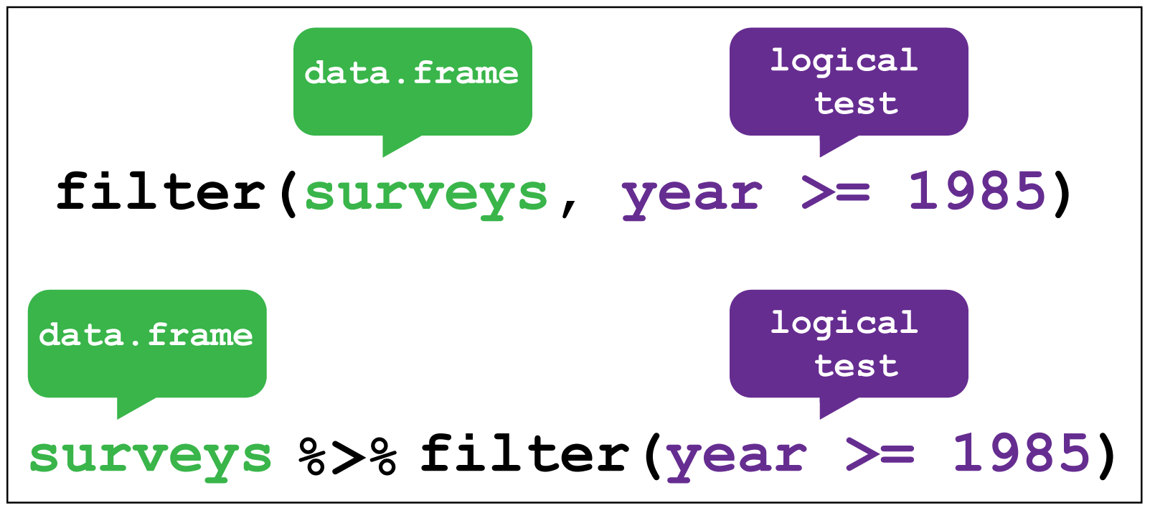
Subsetting Data (observations)
filter()
Extract rows of existing data that meeting logical conditions
Credit: Coding TogetheR
For more check out this RStudio Data Manipulation video from Garrett Grolemund https://www.youtube.com/watch?v=Zc_ufg4uW4U

Slide 13
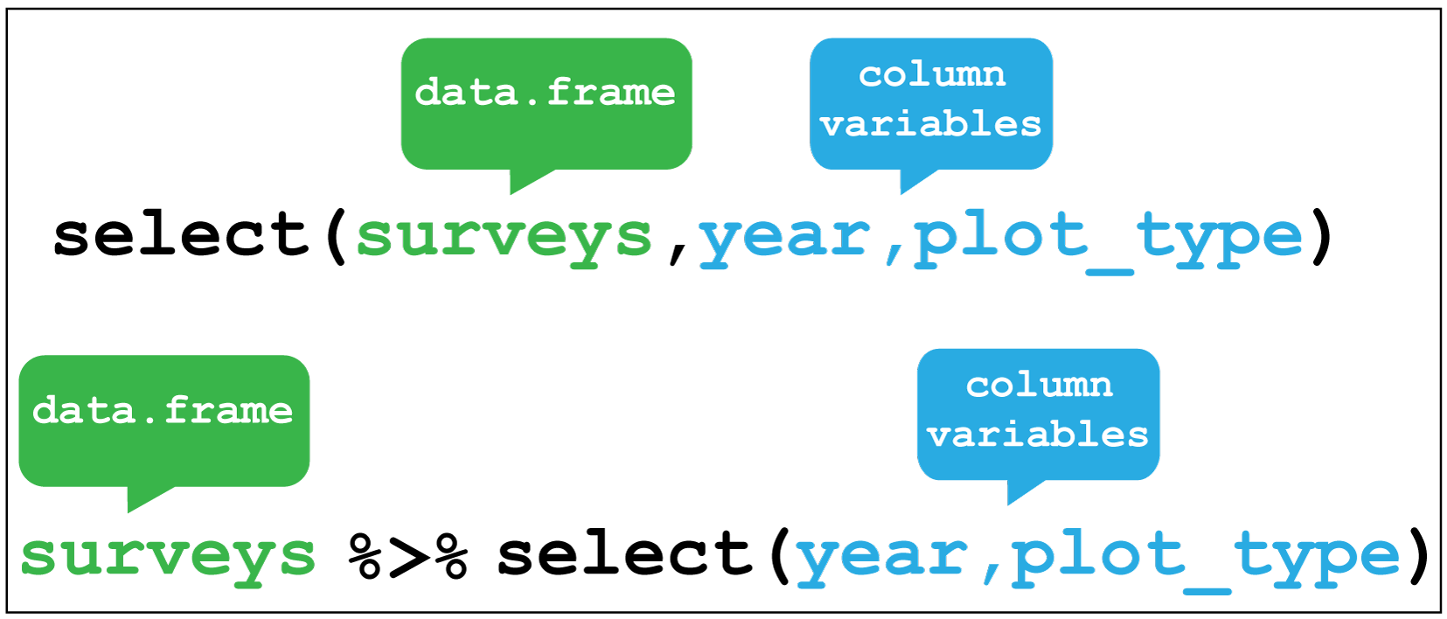
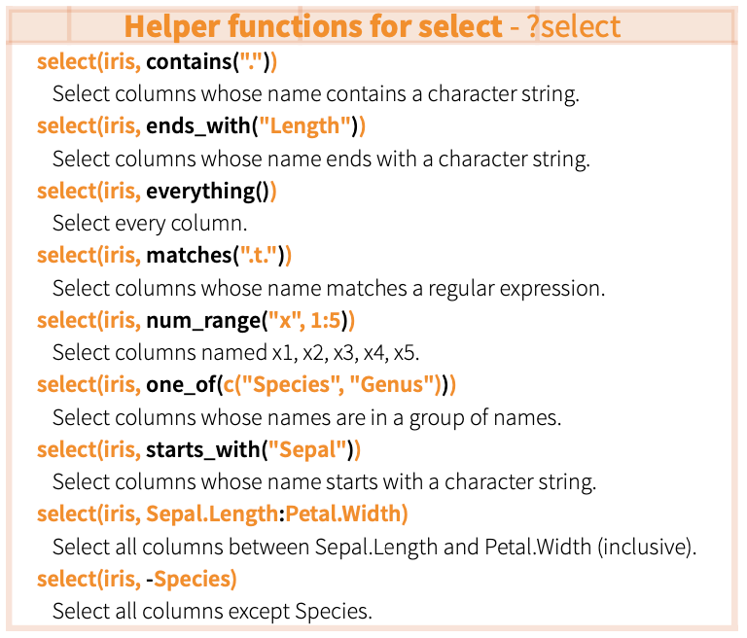
Subsetting Data (variables)
select()
Select columns by name or helper functions
Credit: Coding TogetheR

Slide 14
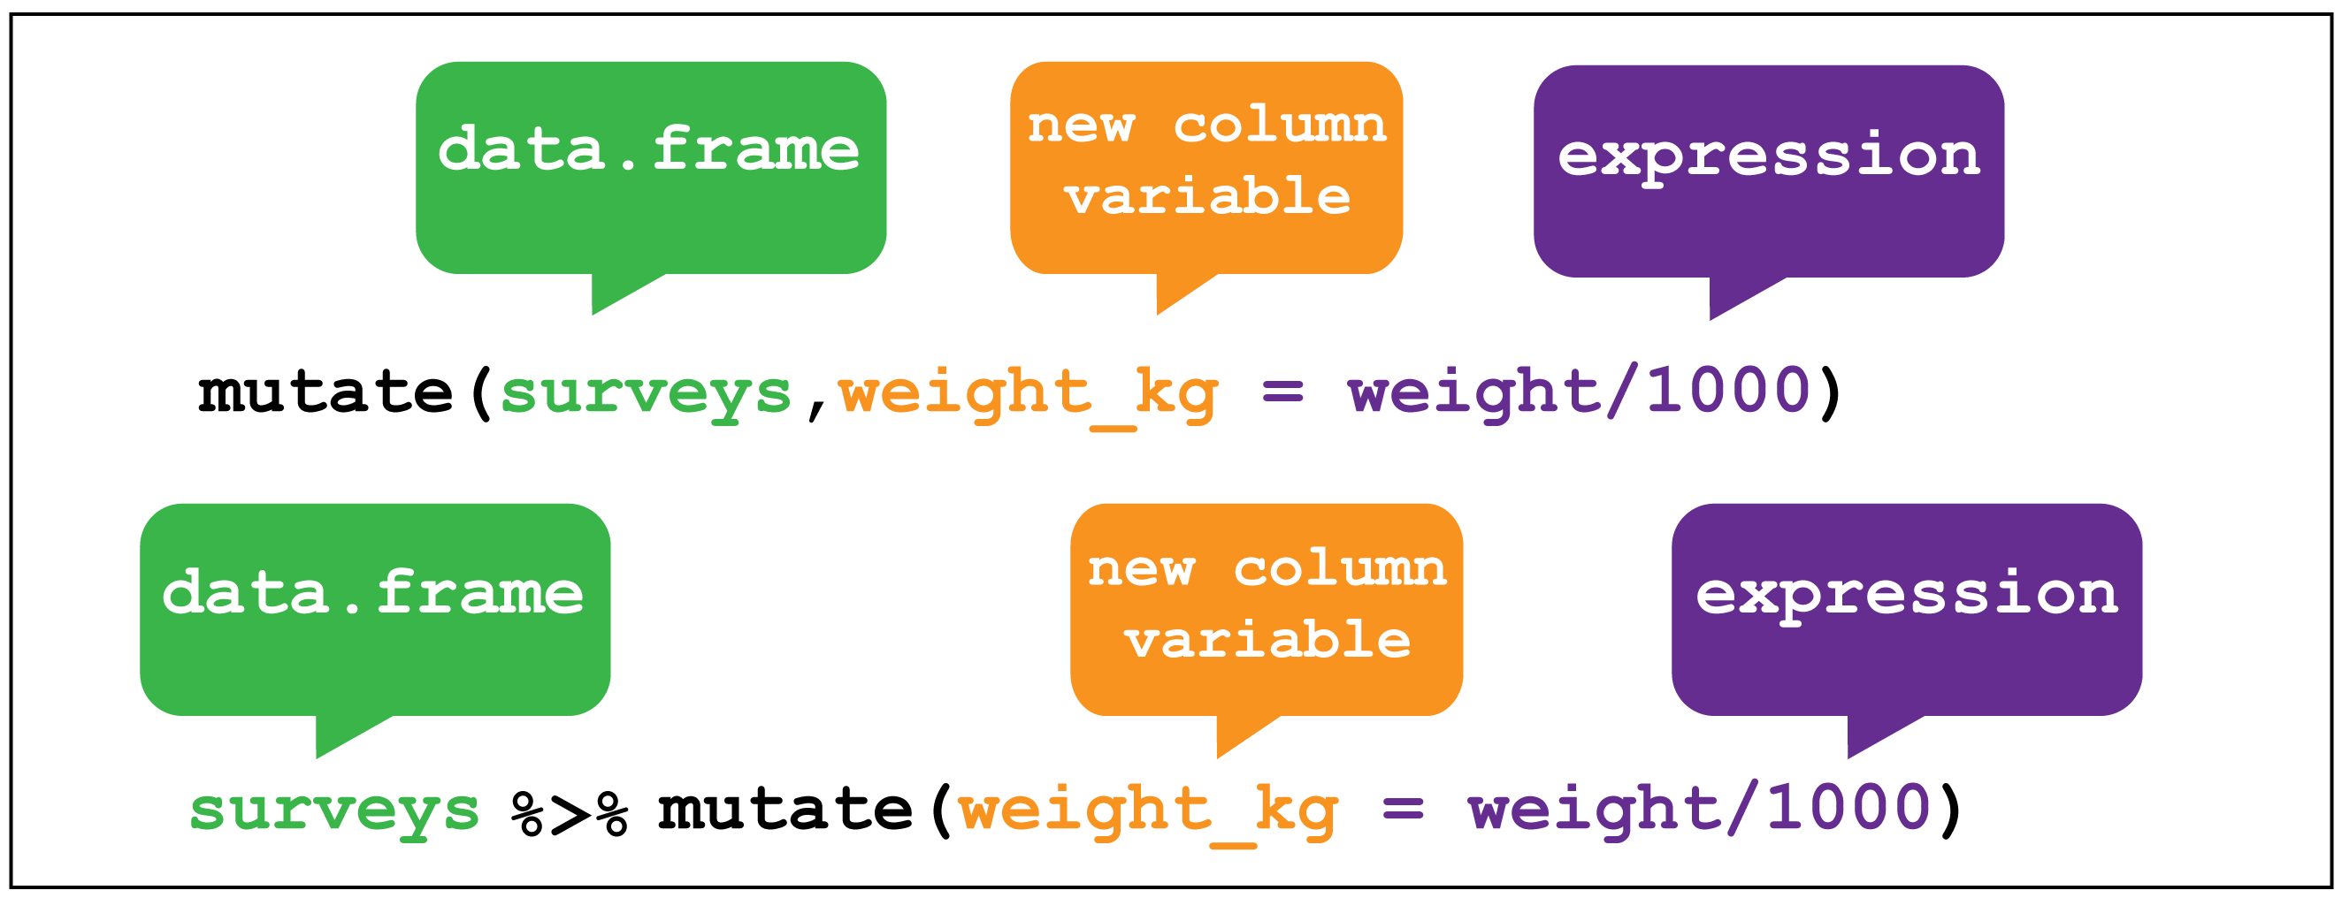
New Variables
mutate()
Compute and append one or more new columns – changes an existing column or adds a new one
Works with grouped data or the whole dataset
Original columns remain after being passed to mutate
Credit: Coding TogetheR
For more check out this RStudio Data Manipluation video from Garrett Grolemund https://www.youtube.com/watch?v=Zc_ufg4uW4U

Slide 15
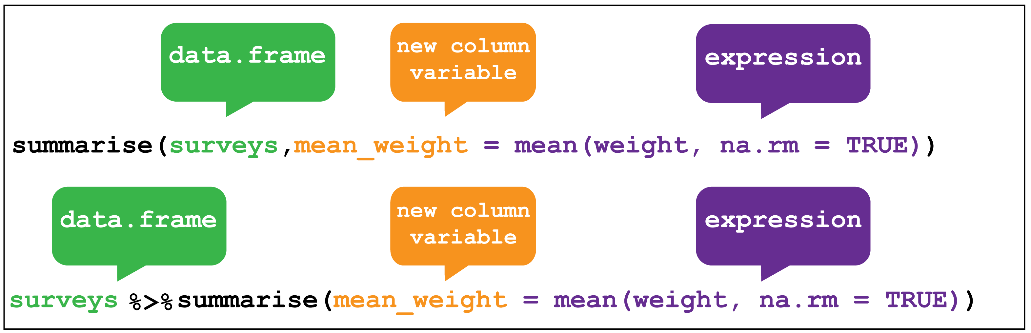
Summarise
summarise()
Summarise data into single row of values
Drops variables not listed in group_by() or created inside it, drops columns after calculating the new one
Credit: Coding TogetheR
For more check out this RStudio Data Manipluation video from Garrett Grolemund https://www.youtube.com/watch?v=Zc_ufg4uW4U

Slide 16
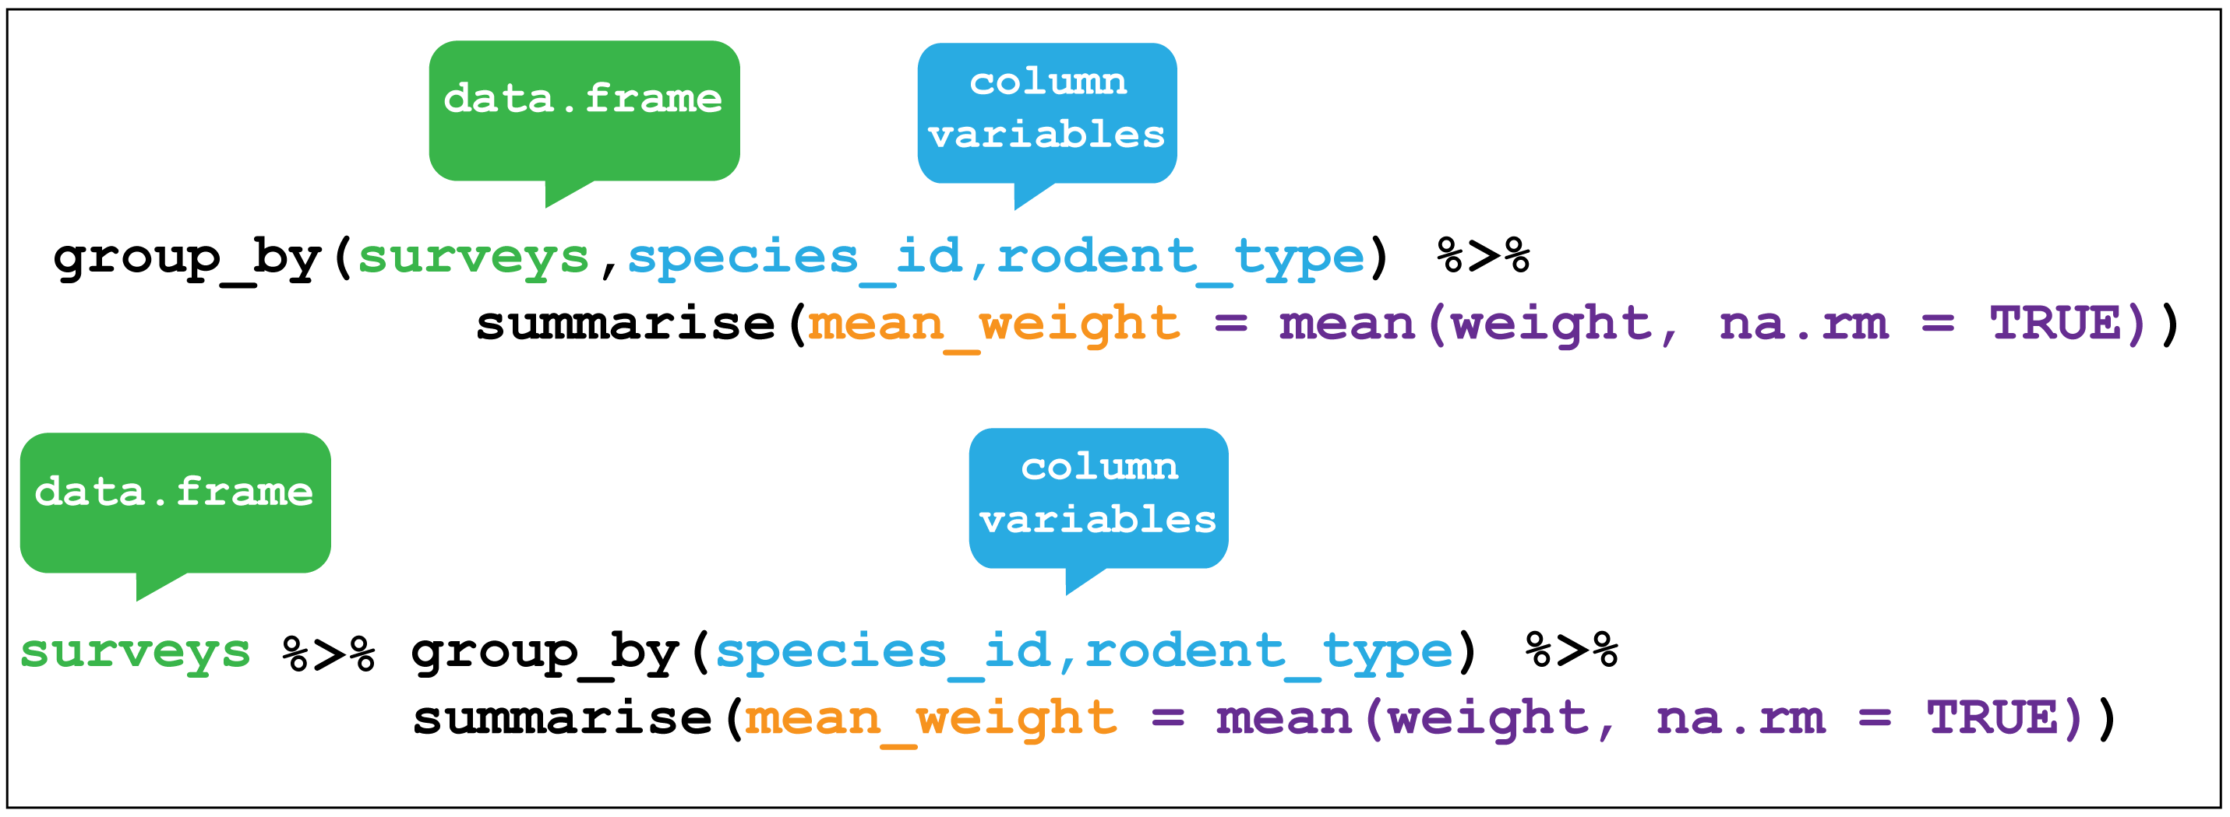
Group Data
group_by()
Group data into rows according to column variables
ungroup()
Remove grouping information from the data frame – particularly useful when wrangling data for tables
Credit: Coding TogetheR
For more check out this RStudio Data Manipluation video from Garrett Grolemund https://www.youtube.com/watch?v=Zc_ufg4uW4U

Slide 17

Data formats & Tidy Data
Ways data can become untidy:
Column headers contain values, rather than names
Multiple variables are stored in a single column
Variables are stored in both rows and columns
Multiple observational types are stored in a single table
A single observational unit is stored in multiple tables
Wickham, H. (2014). Tidy data. Journal of statistical software, 59(1), 1-23.
For more on tidy data see the above paper & Chapter 12 of the R for Data Science Book

Slide 18
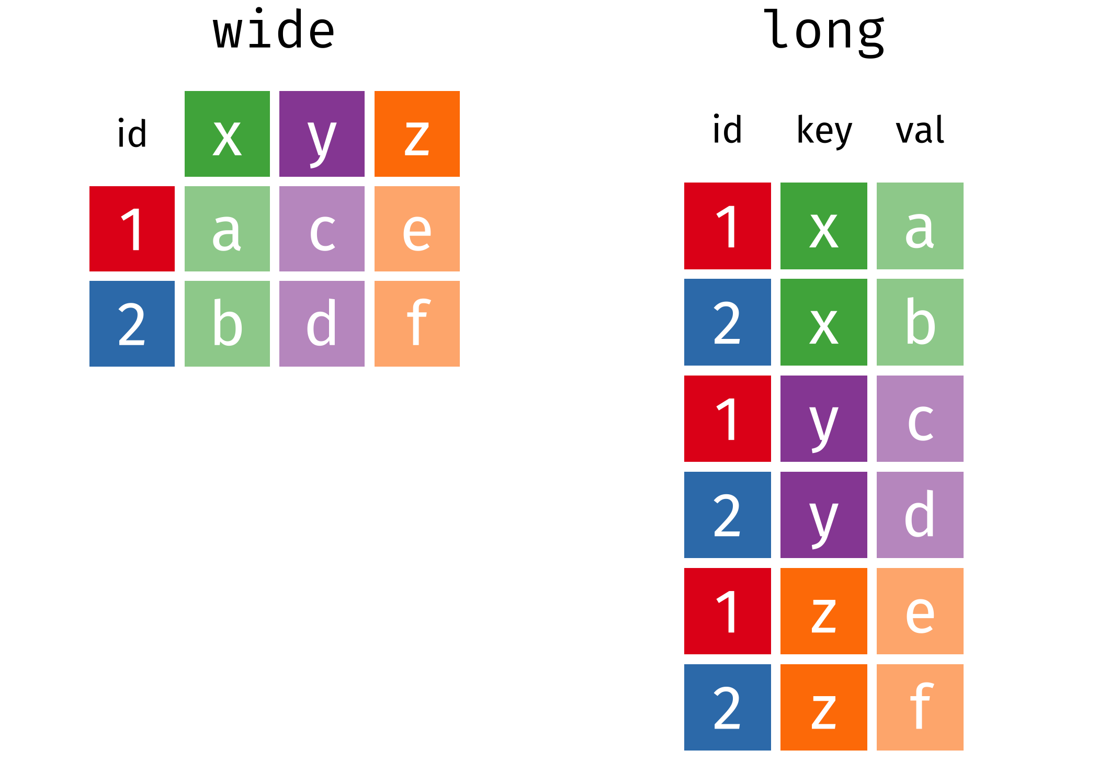
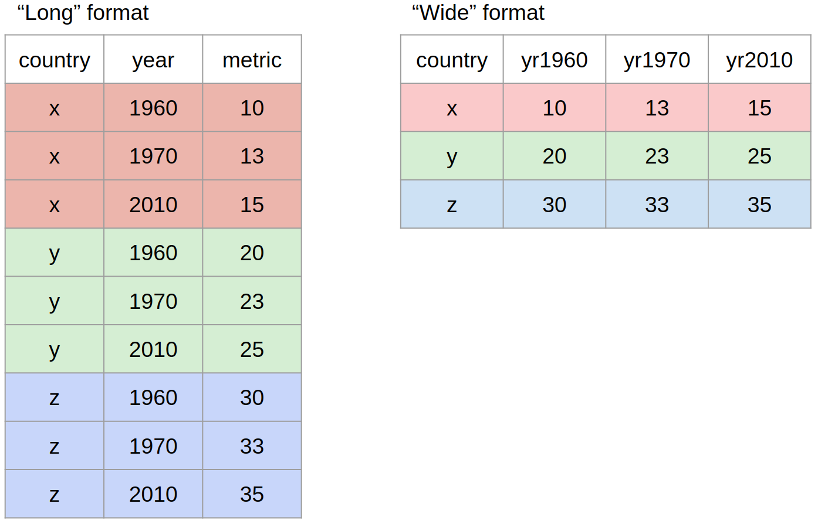
Data formats & Tidy Data
Wide format = generally untidy, but found in many datasets

Slide 19
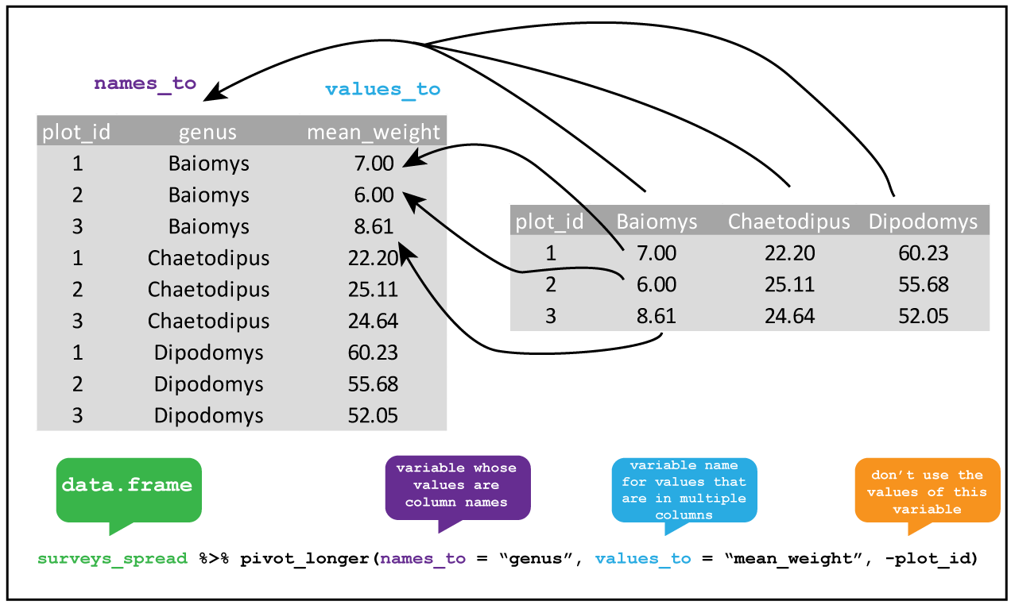
Transforming Data
(wide to long)
pivot_longer()
Requires:
data = data you want to pivot
names_to = name of the column you want to create to capture condition, requires a character string
values_to = name of column you want to contain data values, requires a character string
column X:column Y = range of columns that you have and want to pivot longer, or that you do not want to pivot
Credit: Alistair Bailey’s Coding TogetheR

Slide 20
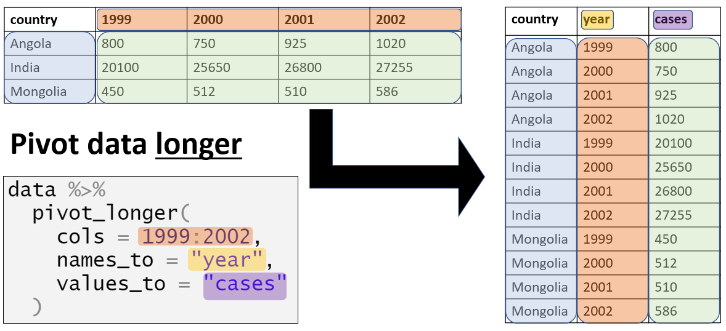
Transforming Data
pivot_longer() = wide to long
Credit: Epidemiologist R Handbook

Slide 21
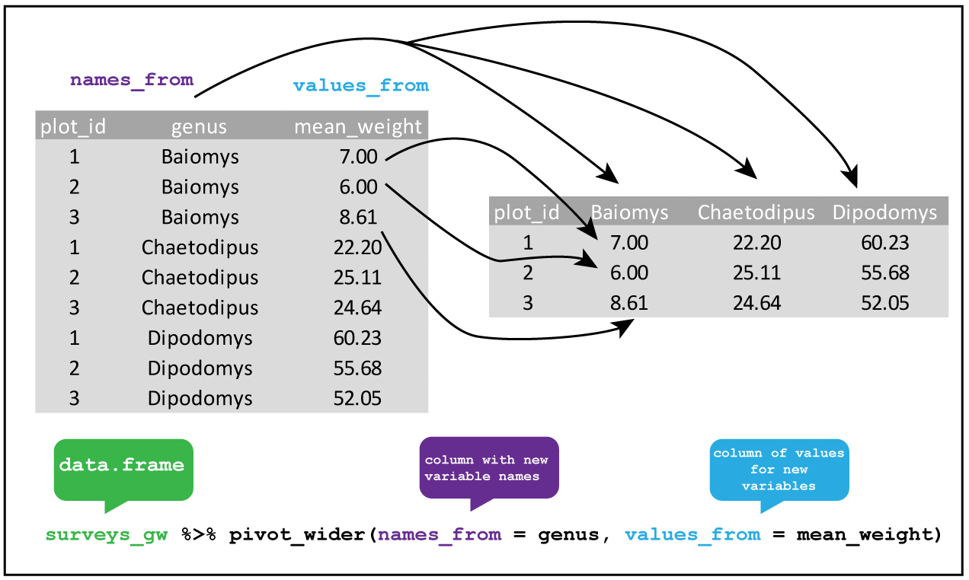
Transforming Data
(long to wide)
pivot_wider()
Requires:
data = data you want to pivot
names_from = name of column you want to end up in several columns
values_from = name of column that currently contains data values
Credit: Alistair Bailey’s Coding TogetheR
For more check out this RStudio Data Wrangling video from Garrett Grolemund https://www.youtube.com/watch?v=1ELALQlO-yM - however includes the now superseded functions gather() & spread()

Slide 22
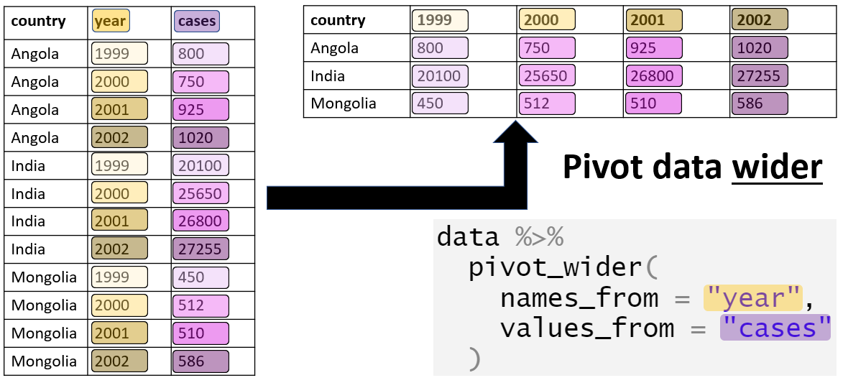
Transforming Data
pivot_wider() = long to wide
Credit: Epidemiologist R Handbook

Slide 23
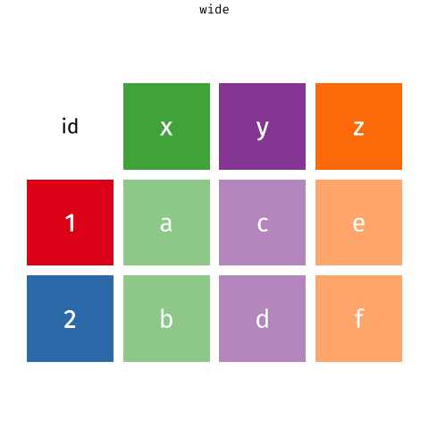
Credit: Garrick Aden-Buie & Mara Averick

Slide 24
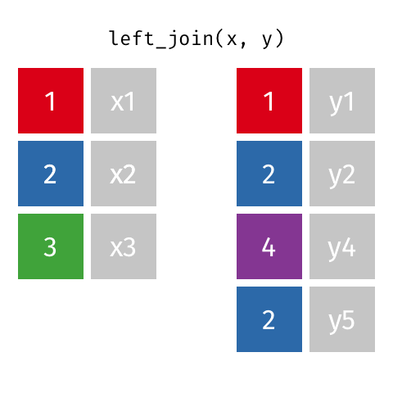
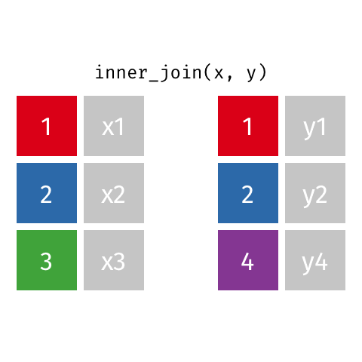
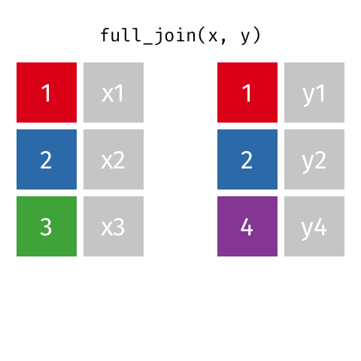
Joins
left_join()
inner_join()
full_join()
For a fun explanation using The Beatles & Rolling Stones see Nic Crane’s tweet:
https://bit.ly/3qfhBb9
Credit: Garrick Aden-Buie
https://www.garrickadenbuie.com/project/tidyexplain/

Slide 25
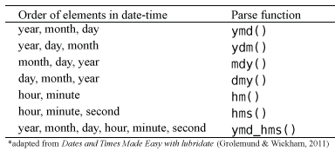
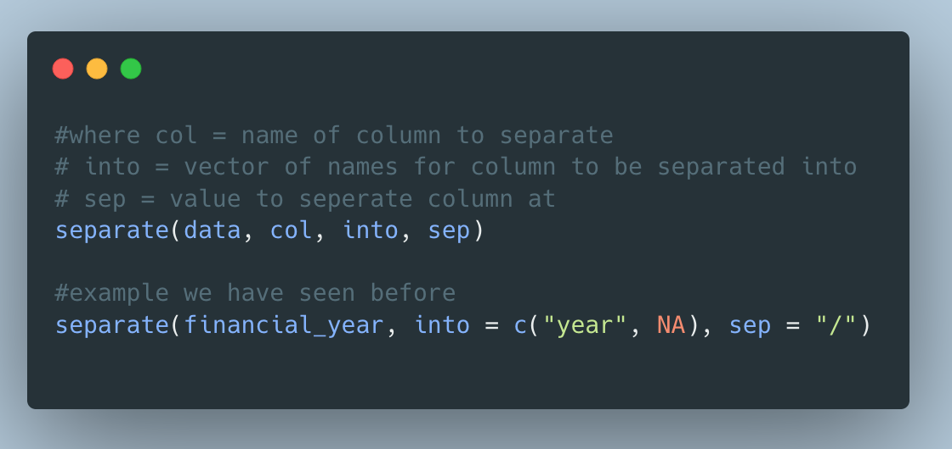

Dates
separate() turns a character column into multiple columns

Slide 26
Factors & Strings
levels() to see the set of levels in the factor
fct_relevel() to manually reorder factor levels
fct_recode() to manually change the levels labels
fct_collapse() to collapse levels into manually defined groups
str_replace() to change the labels of a string
str_wrap() to wrap the text of a string if it is too long into 2+ lines

Slide 27
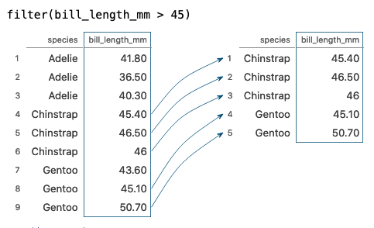
Tidy Data Tutor
Example: Visualisation of the filter() function
A potentially helpful revision and consolidation tool
https://tidydatatutor.com/

Slide 28
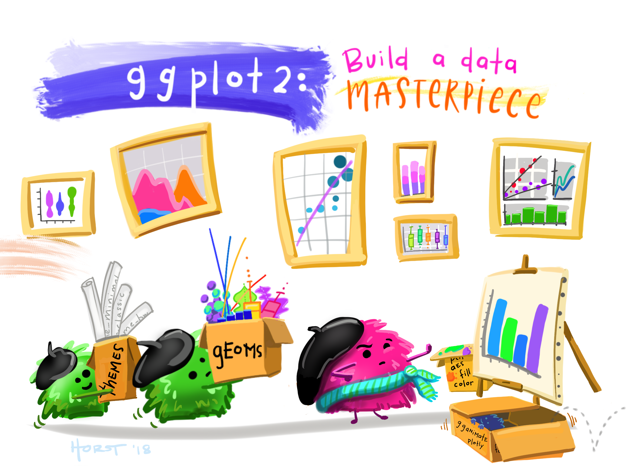
Plotting
Artwork by Allison Horst

Slide 29
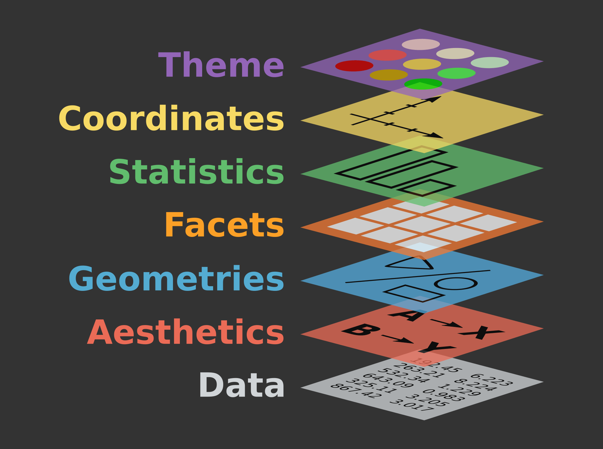
Grammar of Graphics
+ theme_bw() + theme_classic() etc.
+ coord_flip()
Example: + stat_summary()
+ facet_wrap() + facet_grid(x~y)
+ geom_line() + geom_bar() + geom_jitter() etc.
ggplot(data, aes(x, y, color, shape, fill))
ggplot(data)

Slide 30
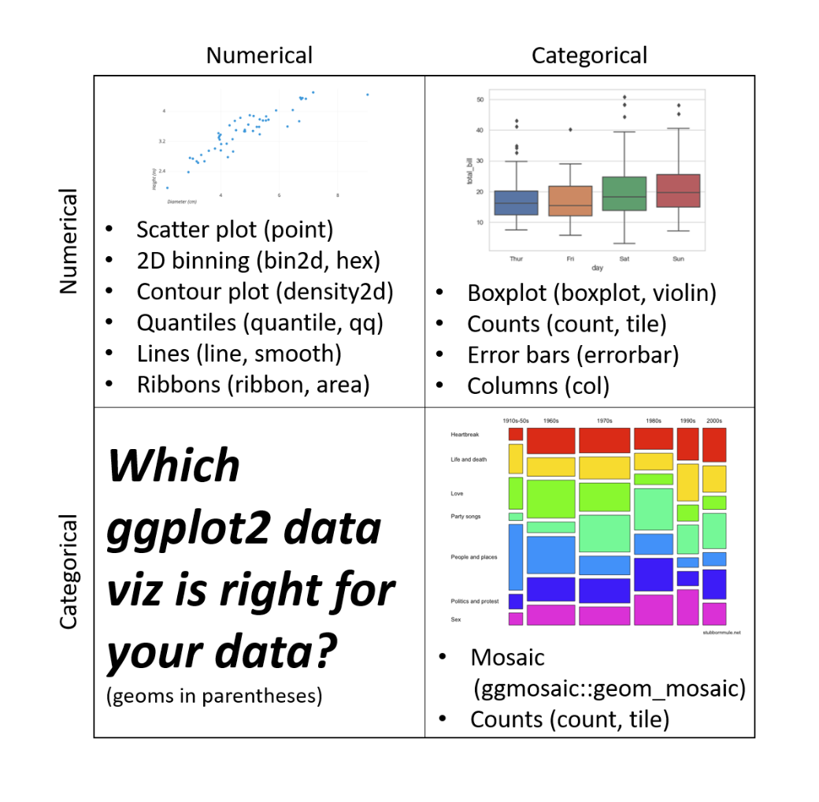
Importance of variable class
From Dr Sam Tyner’s guest lecture recording in Week 4

Slide 31
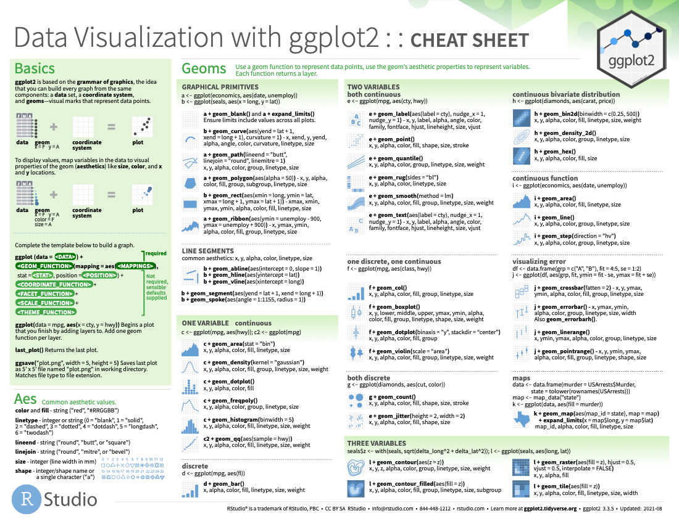
ggplot2
Cheatsheet

Slide 32
Color palettes
Emil Hvitfeldt has created a “one stop destination for anyone looking for a color palette to use in r.” https://github.com/EmilHvitfeldt/r-color-palettes
Including an interactive color selector! https://emilhvitfeldt.github.io/r-color-palettes/discrete.html

Slide 33
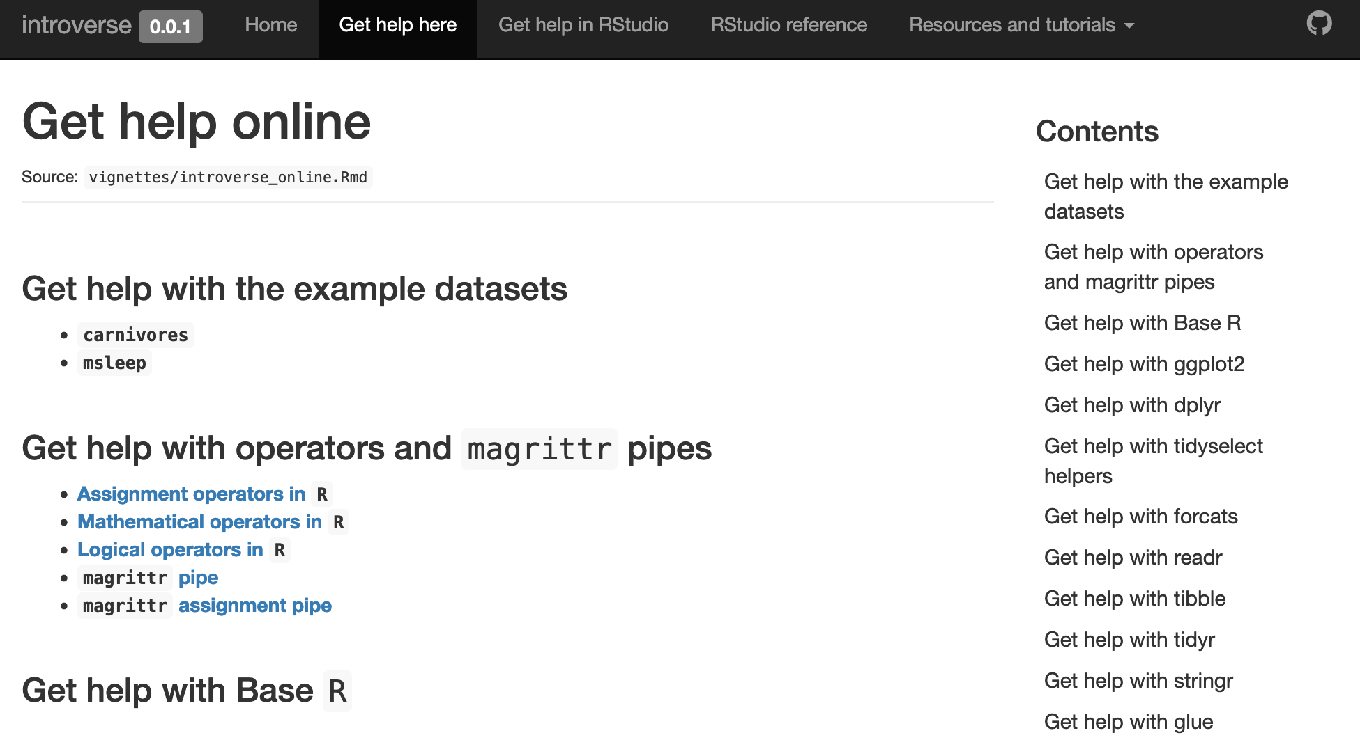
introverse package
https://sjspielman.github.io/introverse/articles/introverse_online.html

Slide 34

Report generation
Artwork by Allison Horst

Slide 35

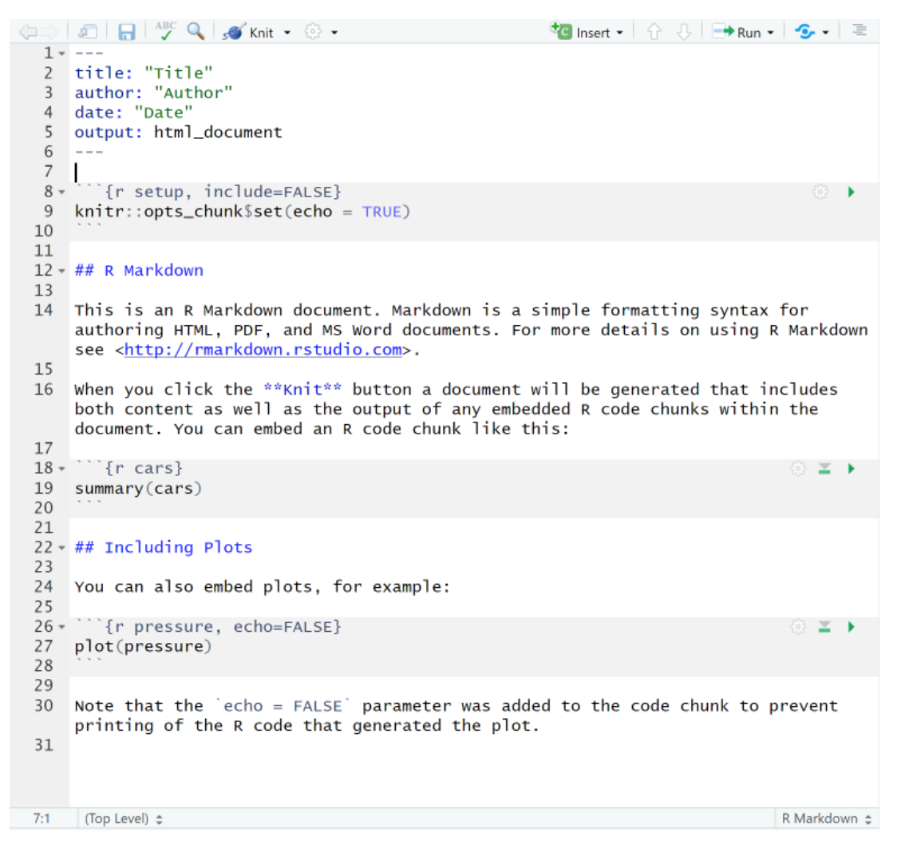
R Markdown
YAML
Code –
setup chunk
Text
kbl() for nice tables
Code
Text
Code
Text

Slide 36
A bit more on knitting to PDFs

Slide 37
Questions?

Slide 38
R Programming Assignment
Due: Monday, 20th March at 12 noon GMT
See Learn pages “Assessments” for more info
Q&A around the assignment Wednesday 1st March 6pm!

